Slide 1

Network engineers can uncross their fingers by emulating hardware and software engineers
Ratul Mahajan
ratul@intentionet.com
@intentionet
Notes:
A synthesis of vision of work that I am doing with colleagues and customers at Intentionet and many collaborators across Princeton, UCLA, Wisconsin Madison, USC, CMU, and Microsoft.
A network engineer, a hardware engineer, and a software engineer walk into a bar. How do you tell which one is the network engineer? They are the one with their fingers crossed and repeating each sentence three times.

Slide 2

Network engineering today: A wide gap between intent and reality
Policy intent
Runtime behavior
Notes:
From the policy intent to actual network behavior there is a big gap today.

Slide 3

Network engineering today: A wide gap between intent and reality
Policy intent
Policy spec
Device config
Dynamic states
Runtime behavior
Network Monitoring
Finds problems post hoc
No correctness assurance
Difficult root cause analysis
Notes:
Bugs can occur in each step of the process. They all accumulate and show up in runtime behavior that is not intended.
The most mature capability to find such unexpected occurrences is network monitoring, which if you are lucky, will catch things as soon as they start going bad.
But networking is too little, too late
- Only finds problems after they occur
- It cannot provide any assurances on correctness of overall network operation
- It is very low-level and cannot provide any context around the faults.
- For instance, if packets monitoring finds that A cannot talk to B, is it because the ACLs are wrong, route maps are wrong, interface MTUs are misconfigured, or device software is buggy? Things are even harder to debug when packets make it across an intended isolation boundaries.
Ideally, you want to find bugs as early in the pipeline as possible. Finding later is costly and makes it harder to debug. But limited tools to find bugs earlier in the pipeline.
Automation helps but provides no guarantees by itself. It is like replacing your manual screwdriver with a power drill. It offers no guarantee that what you are building is correct in the first place.
- In fact, while without automation a fat finger would screw up one router, with automation, it could screw the entire network.

Slide 4


Results of the Intent ↔ reality gap
OUTAGES
SECURITY BREACHES
LACK OF AGILITY
Notes:
End result: High operational cost and damage to the organization’s brand.

Slide 5
Things will only get worse!
HW, SW disaggregation
More (virtual) devices
Transition to hybrid cloud
Increasing network complexity
Ability to handle complexity
Time →
Notes:
If we are to tackle this complexity, we need fundamentally different ways of doing things. Things that are more formal and have a more solid footing.

Slide 6
Idea: Tame network complexity by adapting proven approaches from HW and SW engineering
Provide strong correctness guarantees
Simplify intent expression
Catch bugs early in the pipeline
Enable safe, rapid evolution
Development tools
High-level intent specification
Formal validation
Realizable today using precise models of network control plane
Notes:
The idea behind this talk is a simple: We should learn from what HW and SW engineering communities have done to tame complexity in their own domains.

Slide 7
FORMAL VALIDATION
Intent
Specification
Framework
Network Development Tools
Formal validation

Slide 8
Formal validation
Comprehensive analysis of (aspects of) network behavior
Validate behavior for all nodes, packets, failures, or routing adverts
Is the DNS server globally reachable?
Are two subnets isolated with respect to all traffic?
Do spine routers treat all destinations identically?
Can any unencrypted packet go from A to B?
Will any interface failure lead to connectivity loss?
Can any external announcement disrupt internal connectivity?
Is all communication with the device properly authenticated?

Slide 9
Comparison of validation capabilities
Hardware engineers
Design rule checking
Timing analysis
Functional verification
Mixed-signal verification
Power-aware analysis
Memory models
Equivalence checkers
Gate-level analysis
.....
Network engineers
ping/traceroute

Slide 10
Network validation landscape
Failures, routing adverts
Policy intent
Policy spec
Device config
Dynamic state
Runtime network behavior
Control plane validation
Analyzes configs, all possible network states
Batfish, ARC, Minesweeper, …
Data plane validation
Analyzes the current network state
HSA, VeriFlow, Delta-Net, …

Slide 11
Control plane validation
Analyzes configs, all possible network states
Batfish, ARC, Minesweeper, …
Data plane validation
Analyzes the current network state
HSA, VeriFlow, Delta-Net, …
Can answer all Qs for all possible network states
Can answer some Qs for only the current state
Is the DNS server globally reachable?
Are two subnets isolated with respect to all traffic?
Do spine routers treat all destinations identically?
Can any unencrypted packet go from A to B?
Will any interface failure lead to connectivity loss?
Can any external announcement disrupt internal connectivity?
Is all communication with the device properly authenticated?

Slide 12

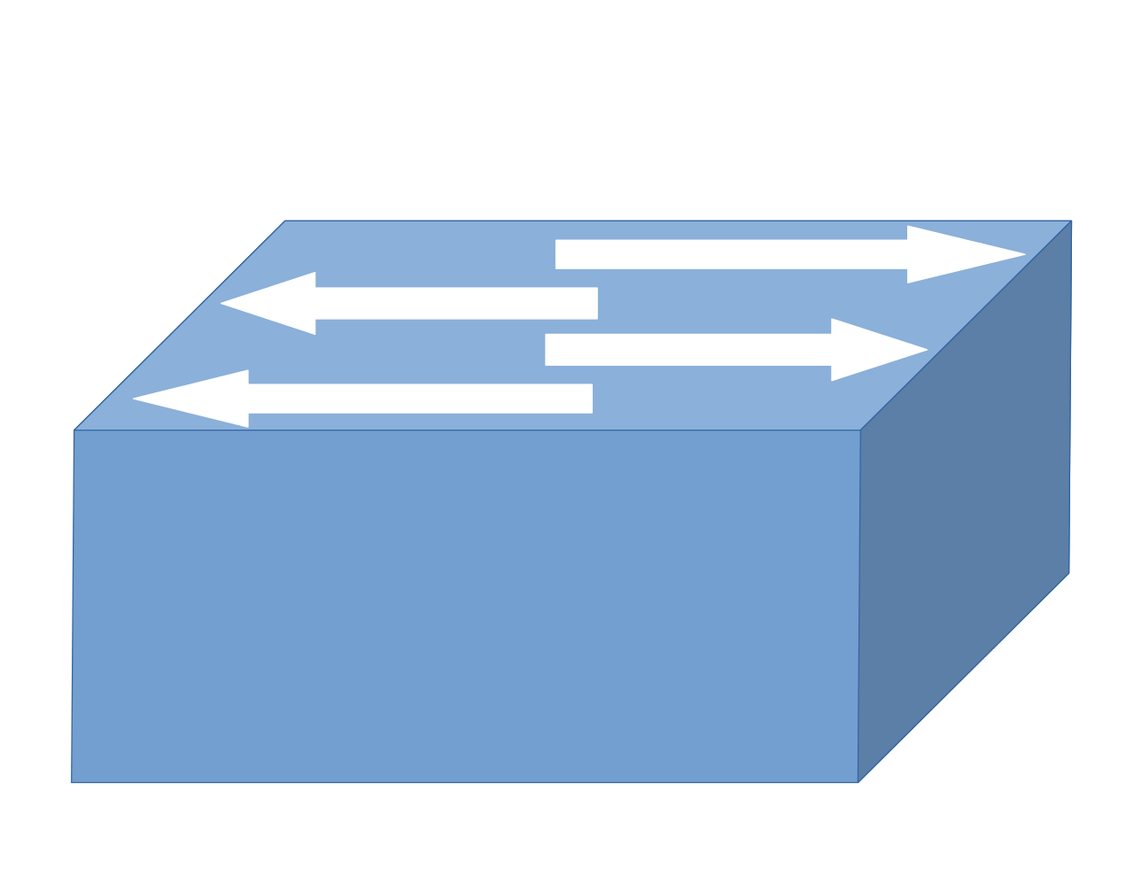




Control plane validation
Interfaces:
Ethernet0/0:
InterfaceCost: 1,
importPolicy: peer_in
……….
192.0.0.0 ≤ out.prefix
out.prefix ≤ 192.1.0.0
best.valid ⇒ out.lp = 120
best.valid ⇒ out.ad = 20
………
Parsers, ASTs
Network models
Configs, metadata
dynamic state
Analysis engine
www.batfish.org
[A general approach to network configuration analysis, NSDI ‘15]
[A general approach to network configuration verification, SIGCOMM‘17]
Intent
Notes:
I want to talk in a bit more detail about control plane validation, since
It is a superset of data-plane validation
Is the foundation for building intent specification frameworks and new network dev tools
It is the area of focus for my research and my company, Intentionet

Slide 13
Constraint-based models
N1
N2
N3
N1
N2
N3
R1
R2
R1 BGP
R2 BGP
S1
S2
S2
S1
S2
S2
CON
OSPF
OSPF
CON
R3
R3 OSPF
CON
Protocol-level breakdown
S3
S3
S3
S3
Notes:
Control plane validation techniques start by building a constraint based network model. Each device and it is associated protocols are converted into a set of graph nodes and edges

Slide 14
Constraint-based models
N1BGP
N1
N2
N3
Redistribution
CON to BGP
BGP message
R1 BGP
R2 BGP
S1
S2
S2
CON
OSPF
OSPF
CON
R1CON
R1BGP
R2BGP
R3 OSPF
View
of R1’s BGP
CON
Protocol-level breakdown
S3
S3
R1OSPF

Slide 15
Constraint-based models
N1BGP
Symbolic message
Redistribution
CON to BGP
BGP message
valid:
1 bit
{
}
prefix:
[0,2³²)
prefixLen:
[0,2⁵)
R1CON
R1BGP
R2BGP
adminDist:
[0,2⁸)
localPref:
[0,2³²)
metric:
[0,2³²)
View
of R1’s BGP
[0,2³²)
med:
ospfType
[0,2²)
R1OSPF
Notes:
Symbolic encoding of the message allows the system to evaluate all possible inputs

Slide 16
Constraint-based models
Logical constraints
if out4.valid ∧ failed_R1_R2 = 0 then if ¬ (FBM(out4.prefix, 192.168.0.0, 16) ∧
16 ≤ out4.prefixLen ≤ 32) then
in4.valid = true in4.lp = 120 in4.ad = out4.ad in4.prefix = out4.prefix
in4.metric = out4.metric
in4.prefixLen = out4.prefixLen
else in4.valid = false
else in4 .valid = false
Redistribution
CON to BGP
N1BGP
BGP message
R1CON
R1BGP
R2BGP
R1 BGP import filter from R2
ip prefix_list L deny 192.168.0.0/16 le 32
ip prefix_list L allow
route-map R1_Import_From_R2 10
match ip address prefix-list L
set local-preference 120
View
of R1’s BGP
R1OSPF
Notes:
Creation of logical constraints enables the system to limit the number of input variables

Slide 17
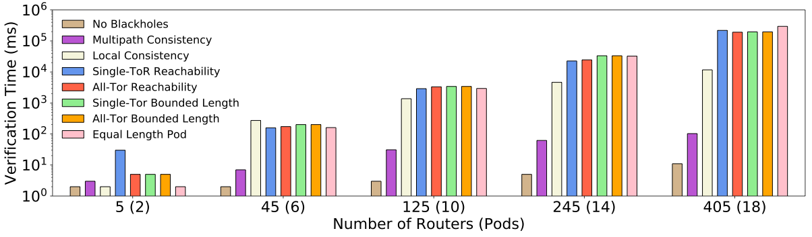
Control plane validation for large networks
< 5 minutes
Validation time (ms)
Number of routers (pods)

Slide 18
Open problems in network validation
Special packet handling
E.g., DPI-based, stateful packet transformations
Performance
E.g., Will a traffic matrix lead to buffer overruns?

Slide 19
HIGH-LEVEL INTENT SPECIFICATION
Development tools
High-level intent specification
Formal validation

Slide 20
High-level intent specification
Allow intent specification at a high-level and automatically synthesize device configurations
Reduce the gap between intent and specification
Guarantee correctness for synthesized configurations

Slide 21
Intent specification landscape
General networks
Cisco IOS OpenConfig
???
Specific
designs
Cisco ACI
Device-level
specification
Network-wide
specification

Slide 22
Hazards of device-level specification
→tag “X”
→block “X”
X
←block “Y”
←tag “Y”
Y
A
D
LP=99
LP=99
B
C
LP=98
LP=101
filter 16.4.0.0/16
filter 16.4.0.0/16
Z
Policy intent
No transit between X,Y
Prefer C > B > {X,Y}
Use Z only for 16.4.0.0/16
Notes:
On the way here, I heard about Google and Verizon screwing up their route filters, which led to chunks of Japan going offline.
https://bgpmon.net/bgp-leak-causing-internet-outages-in-japan-and-beyond/

Slide 23
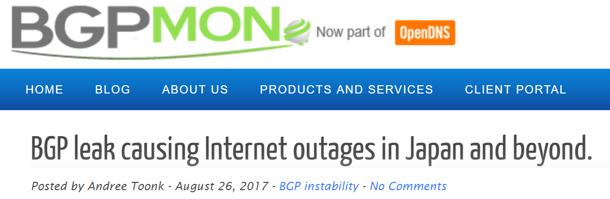
Hazards of device-level specification
→tag “X”
→block “X”
X
←block “Y”
←tag “Y”
Y
A
D
LP=99
LP=99
B
C
LP=98
LP=101
filter 16.4.0.0/16
filter 16.4.0.0/16
Z
Policy intent
No transit between X,Y
Prefer C > B > {X,Y}
Use Z only for 16.4.0.0/16
Notes:
On the way here, I heard about Google and Verizon screwing up their route filters, which led to chunks of Japan going offline.
https://bgpmon.net/bgp-leak-causing-internet-outages-in-japan-and-beyond/

Slide 24
Intent specification landscape
General networks
Cisco IOS OpenConfig
???
Specific
designs
Cisco ACI
Device-level
specification
Network-wide
specification

Slide 25


Propane: General, network-wide specification
Today
BGP configs
0,0
1,1
0,1
2,1
Policy in the Propane language
Propane Compiler
www.propane-lang.org
[Don’t mind the gap: Bridging network-level objectives and device-level configurations, SIGCOMM ‘16]
[Network configuration synthesis with abstract topologies, PLDI ‘17]
Notes:
New high-level language, similar in spirit to many SDN languages
A couple of key differences
The mechanisms for achieving inter domain routing and SDN are non-existent

Slide 26
Propane specification language
→tag “X”
→block “X”
X
←block “Y”
←tag “Y”
Y
A
D
LP=99
LP=99
B
C
LP=100
LP=101
filter 16.4.0.0/16
filter 16.4.0.0/16
Z
Policy intent
No transit between X, Y
Prefer C > B > {X,Y}
Use Z only for 16.4.0.0/16
define notransit = {true => not transit({X, Y})}
define preference = {true => exit (C >> B >> {X, Y})}
define ownership = {16.4.0.0/16 => end(Z)}
define main = notransit and preference and ownership

Slide 27
Propane compiler
0,0
XAB
(Σ*)Y
0
1
2
1,1
0,1
0
1
2,1
Policy
Regular IR
Reverse automata
Product graph
BGP Configs

Slide 28
Propane compiler: A simple example
X
A
D
Y
C
B
E
P => (path(X,A,C,D) >> any) & end(Y)

Slide 29
(1) Policy → Regular IR
X
A
D
Y
C
B
E
P => (path(X,A,C,D) >> any) & end(Y)
XACDY >> (Σ*)Y

Slide 30
(2) Regular IR → Reverse automata
X
A
D
Y
C
B
E
Y
D
C
A
X
1. XACDY
2. (Σ*)Y
0
1
2
3
4
5
Σ
Reverse automata
track BGP message flow
Y
0
1

Slide 31
(3) Reverse automata → Product graph
(-,0,0)
X
A
D
Y
(Y,1,1)
C
B
E
(E, -,1)
(D,2,1)
Y
D
C
A
X
(C, -,1)
(D, -,1)
(C,3,1)
0
1
2
3
4
5
Σ
(A, -,1)
(B, -,1)
(A,4,1)
Y
Product graph captures all policy-compliant paths for BGP messages
0
1
(X, -, 1)
(X,5,1)
{2}
{1,2}
Notes:
Encode PG state in community tags
Generate import and export filters
Compute regret-free preferences
Higher preferences offer equally good or better paths under all failures

Slide 32
Propane compiler
0,0
XAB
(Σ*)Y
0
1
2
1,1
0,1
0
1
2,1
Policy
Regular IR
Reverse automata
Product graph
BGP Configs
Guarantees
Policy compliant for all possible failures
Only neighbor configs change upon link addition or removal

Slide 33
Propane on real networks
Data center
Backbone network
31 lines of Propane
43 lines of Propane
Human designed configurations were O(10K) lines!
Notes:
Policies translated from English documents
Recent work: make it even faster and evolution friendly.

Slide 34
Open questions for intent specification
What is the right “altitude” for intent specification?
Does there exist one language for all concerns?

Slide 35

Control plane models enable intent specification experiments
Security
Routing
Performance
Safely try different intent specification methods
Including home-grown ones
Safely make tactical changes
Safely combine multiple specification methods

Slide 36
DEVELOPMENT TOOLS
Development tools
High-level intent specification
Formal validation

Slide 37
Development tools
Tools embedded in network engineering workflow
Make validation and synthesis technologies accessible
Accelerate design and change process

Slide 38
Comparison of available dev tools
Software engineers
Unit testing
Continuous integration
Linters
Dead code detection
Type checkers
Style enforcers
Debuggers
IDEs
.....
Network engineers
vi
Emacs

Slide 39
Control plane models enable dev tools Linting, dead code detection
Configuration
3 undefined references
25 unused declarations
1 device has non-standard NTP server
Line 3 of ACL_peer is unreachable ……

Slide 40
Control plane models enable dev tools Unit testing
Configuration
All devices must be password protected
All interface MTUs must be >= 1500
……

Slide 41
Control plane models enable dev tools Continuous integration
Planned configuration
Deploy
DNS server should be globally reachable
No connectivity loss upon any single-interface failure
……

Slide 42
Control plane models enable dev tools Change analysis
Planned configuration
Flow A is blocked in the planned configuration
Flow B takes a different path
……
Reference configuration

Slide 43
Summary: A new networking engineering workflow
Policy intent
Policy spec
Device config
Dynamic states
Runtime behavior
Development tools
High-level intent specification
Formal validation
Network Monitoring
Possible today!
Provide strong correctness guarantees
Catch bugs early in the pipeline
Simplify intent expression
Enable safe, rapid evolution

Slide 44
Design and evolve your network like software
ratul@intentionet.com @intentionet

